Slide 1
Beer and Brewery
Tadd Backus & Austin Webb
June 14, 2022

Slide 2
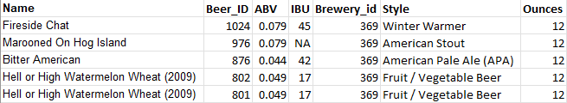
What is the Data?
Beer Dataset:
2,410 rows and 7 columns
Name: Name of the beer
Beer_ID: Unique identifier of the beer
ABV: Alcoholic by volume of the beer
IBU: International bitterness units of the beer
Brewery_ID: Brewery id associated with the beer
Style: Style of the beer
Ounces: Ounces of beer

Slide 3
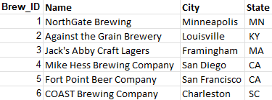
What is the Data?
Brewery Dataset:
558 rows and 4 columns
Brew_id: Unique identifiers of the brewery
Name: Name of the brewery
City: City where the brewery is located
State: U.S. state where the brewery is located

Slide 4
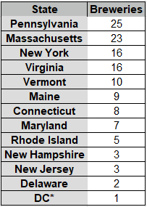
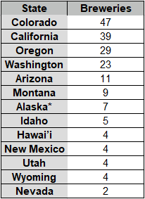
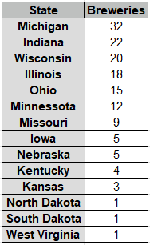
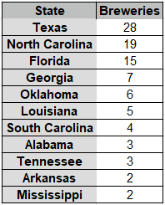
How Many Breweries in Each State

Slide 5
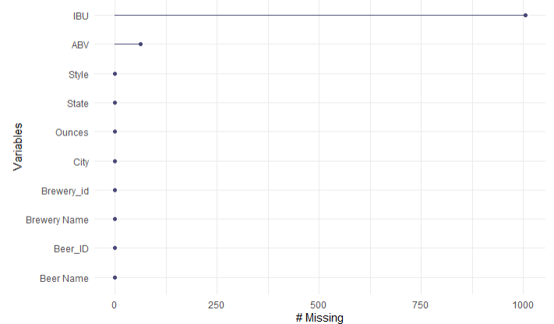
Address the Missing Values
ABV has 62 missing values (2.57%)
IBU has 1005 missing values (41.70%)
Used a statistical procedure called kNN to impute the data

Slide 6
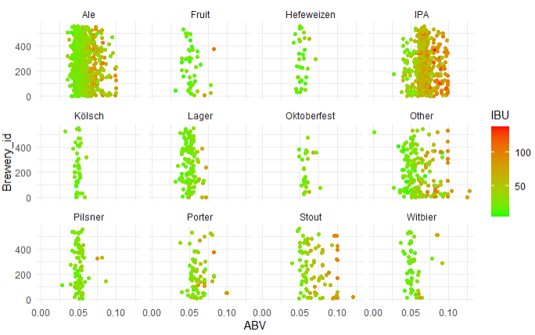
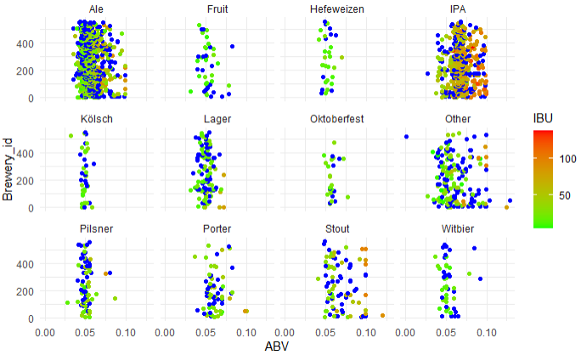
Address the Missing Values
Grouped the beers into 12 types based on their name
Imputed the missing values with five closest beers of the same type

Slide 7
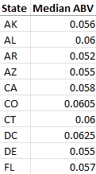
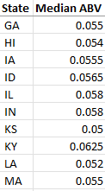
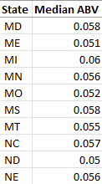
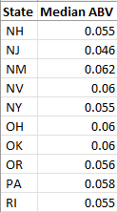
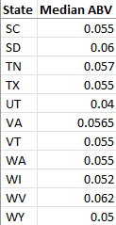
Median ABV for Each State
We can see the median ABV for each state

Slide 8
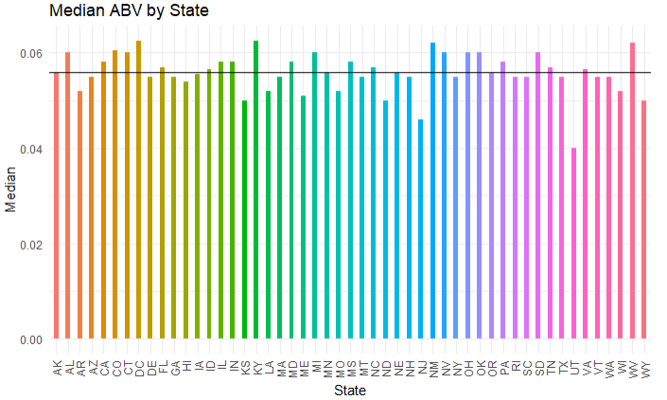
Median ABV for Each State
We can visually see how each state’s median ABV compares to each other
Horizontal line is the mean (0.05588)

Slide 9
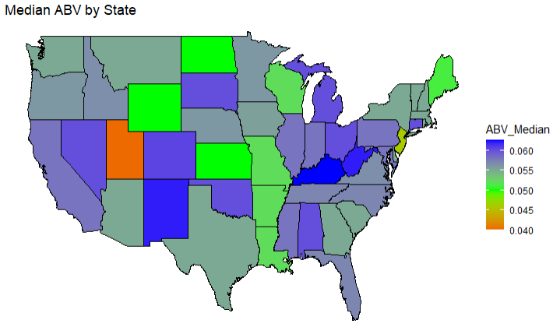
Median ABV for Each State
Utah is clearly the holder of the lowest median ABV at 0.04
Kentucky has the highest median ABV with 0.0625

Slide 10
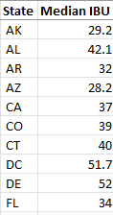
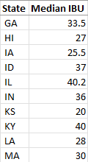
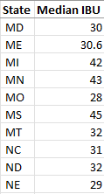
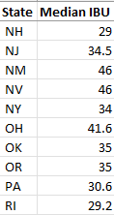
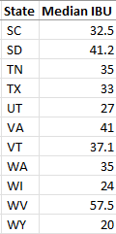
Median IBU for Each State
We can see the median IBU for each state

Slide 11
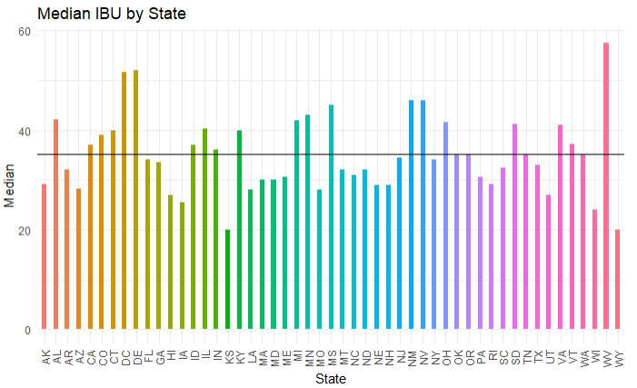
Median IBU for Each State
We can visually see how each state’s median IBU compares to each other
Horizontal line is the mean (35.082)

Slide 12
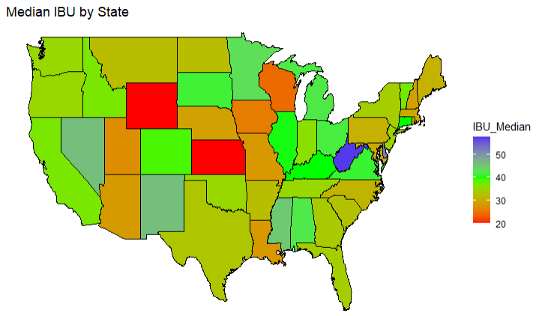
Median IBU for Each State
Wyoming and Kansas are tied for the lowest median IBU with 20
The highest median IBU is West Virginia with 57.5

Slide 13
Max ABV
We searched the database and extracted this row
Max ABV is found in Boulder, Colorado
Max ABV is 0.128

Slide 14
Max IBU
We searched the database and extracted this row
Max IBU is found in Astoria, Oregon
Max IBU is 138

Slide 15
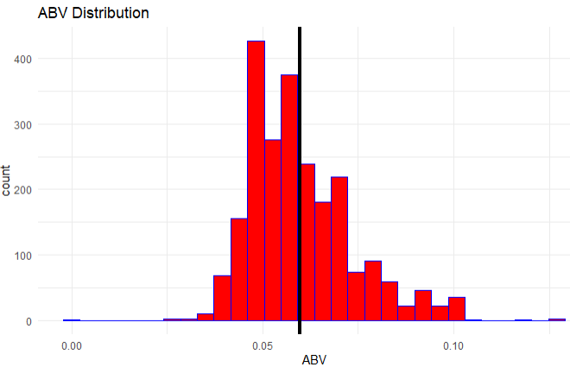
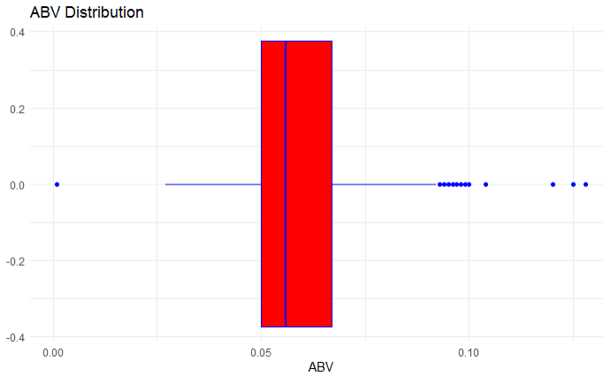
ABV Statistics
Minimum: 0.001
1st Quarter: 0.05
Median: 0.056
Mean: 0.05976
3rd Quarter: 0.067
Max: 0.128

Slide 16
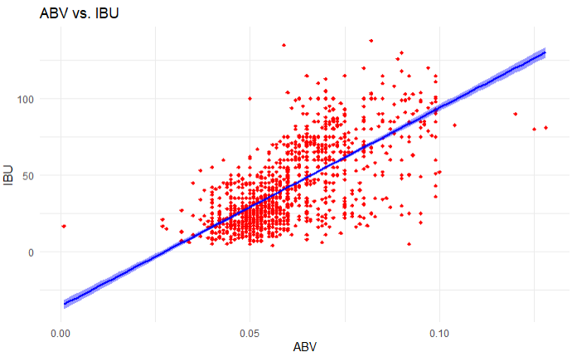
Relationship Between ABV and IBU
The correlation coefficient is 0.7222
This suggests that the average unit of IBU will increase by 0.7222 units for every one unit of increase in ABV,

Slide 17
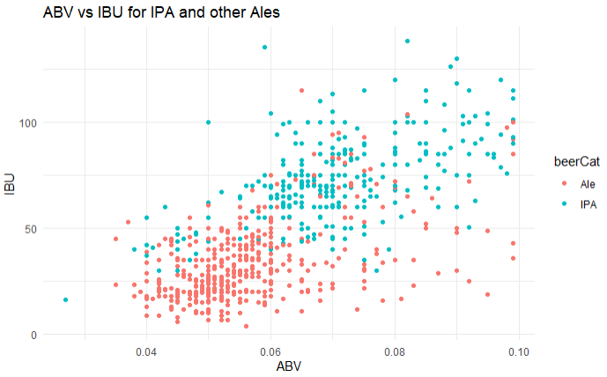
Relationship Between IPA and Other Ales
Ales tend to have a lower ABV & IBU
IPAs tend to have a higher ABV & IBU

Slide 18
Future of the Project
We would like to further our investigation and identify the difference with respect to ABV and IBU between IPAs and other ales.
We also conducted all the previous tests and plots with the missing values deleted and imputed as the mean of those columns.
We would like to see if there is significant difference between the ways we deal with the missing values.

Slide 19
Contact Info
Tadd Backus
tbackus@mail.smu.edu
Austin Webb
austinwebb@mail.smu.edu

